Slide 1


TỔNG QUAN HỆ THỐNG VIETTEL IMS
Tác giả: Nguyễn Đức Linh
19/10/2020

Slide 2

NỘI DUNG
PHẦN 1: TỔNG QUAN HỆ THỐNG IMS
PHẦN 2: CHỨC NĂNG
PHẦN 3: CALL FLOW DỊCH VỤ

Slide 3


IMS là gì?
IMS là:
– một kiến trúc mạng
– cung cấp các dịch vụ tới người dùng đầu cuối trên mạng IP
Multitude of
Applications
IMS
IMS hỗ trợ:
Multi-Media
Multi-Service
Multi-Access
Multi-Terminal
IP
3

Slide 4
Viettel IMS hỗ trợ đồng thời mạng
mobile và fixedline
IMS là gì?
Viettel IMS
SBG
CSCF
DNS
MTAS
MRFC
GSM/ WCDMA
LTE
DSL
WLAN
PSTN
GSM WCDMA
LTE
4

Slide 5
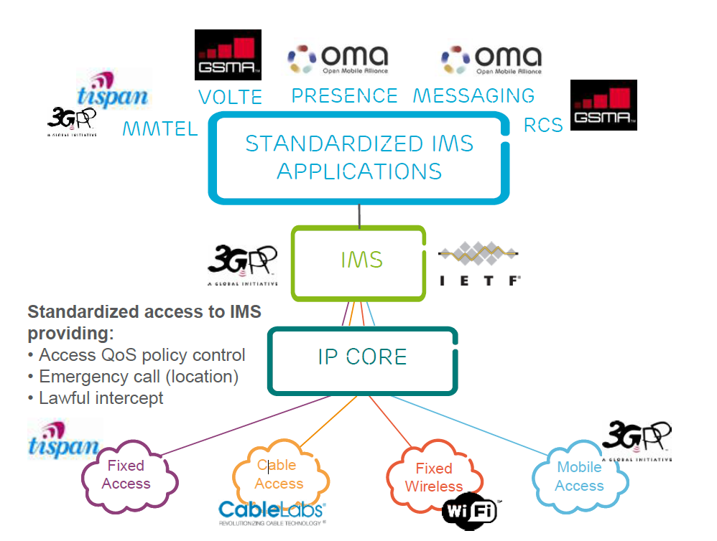
IMS là gì?
Các chuẩn trong IMS
3

Slide 6
Kiến trúc hệ thống Viettel IMS
3

Slide 7
Phân hệ IMS-CORE
Phân hệ IMS-CORE có 2 chức năng chính là:
- Interrogating Call Session Control Function (I-CSCF)
- Serving Call Session Control Function (S-CSCF)
3

Slide 8
Phân hệ IMS-CORE
Interrogating CSCF (I-CSCF)
HSS
Cx
Mw
Mw
P-CSCF
I-CSCF
S-CSCF
3
Ma
AS
Notes:
I-CSCF is a SIP stateless proxy located at the edge of IMS domain
I-CSCF is involved to find the S-CSCF at;
Registration
Terminating requests
The address of the I-CSCF is listed in the DNS records of the domain
I-CSCF has an interface to SLF and HSS (to be able to find the S-CSCF for a specific user)
Proxies SIP requests to S-CSCF or Application Servers
The I-CSCF is the contact point inside an operator’s network for all SIP requests destined to a user of that network operator. It locates the S-CSCF that was assigned to the user at registration through interaction with HSS
Cx Reference Point - The Cx interface is used for authentication, authorization and location of a user between I-CSCF and HSS.
Ma Reference Point – This interface between I-CSCF and the Application Servers is used to:
• Forward SIP requests destined to a Public Service Identity (PSI) hosted by an Application Server directly to the Application Server.
• Originate a session on behalf of a user or Public Service Identity, if the AS has no knowledge of a S-CSCF assigned to that user or Public Service Identity.
Mw Reference Point – The Mw reference point allows the communication and forwarding of signaling messaging between CSCFs, e.g. during registration and session control.

Slide 9
Phân hệ IMS-CORE
Serving CSCF (I-CSCF)
HSS
Cx
Mw
Mw
P-CSCF
S-CSCF
I-CSCF
3
ICS
AS
Notes:
This figure shows the main interworking interfaces for S-CSCF. We can see that the S-CSCF is a central node in the IMS system, with SIP interfaces towards the other CSCF nodes, Application Servers and Diameter interfaces towards HSS
The S-CSCF is located in the home network, and performs the following main tasks:
• Subscriber registration, acting as a SIP Registrar.
• Downloading and caching of the HSS user profile with service trigger data.
• Trigger based invocation of the application servers in order to provide multimedia services.
• Number internationalization from local numbers to global numbers.
• Querying of the ENUM DNS for translation of E.164 numbers and domain names.
• Routing of sessions
• Supervision of ongoing sessions
• Forking of Multimedia sessions
Cx Reference Point – The Cx interface is used for authentication, authorization and location of a user between S-CSCF and HSS. It is also used to download provisioned user data from the HSS to the S-CSCF.
ISC Reference Point – This interface between S-CSCF and the Application Servers is used to provide services for the IMS.
Mw Reference Point – The Mw reference point allows the communication and forwarding of signaling messaging between CSCFs, e.g. during registration and session control.

Slide 10
Phân hệ SBC
Phân hệ SBC (Session Border Control) có 2 chức năng chính là:
- Proxy Call Session Control Function (P-CSCF)
- Border Gateway Function(BGF)
3

Slide 11
Phân hệ SBC
Access Networks
SBC
P-CSCF
Rx
PCRF
Gm
IMS ALG
Mw
3
CSCF
Mb
Iq
IMS
BGF
Mb
Notes:
P-CSCF functionality in the SBC
P-CSCF is the first point of contact (1) for the User Equipment.
It forwards SIP requests (2) from the access network to the home network, and vice versa, and keeps track of registrations (3) and call sessions.
The SBC, in the P-CSCF role, performs correlation (4) and funneling of signaling and media across the interface between the IMS core and the access network.

Slide 12
Phân hệ MMTel AS
HSS
Sh
ISC
Ma
S-CSCF
AS
I-CSCF
Mr’
MRFC
Notes:
Enriched real time communication experience
2-party Voice & Video
Add/Drop Media
Conferencing
MMTel Supplementary Services
For example Call Hold, Communication Barring, Communication Diversion, Identity Presentation, Ad-hoc Conferencing etc.

Slide 13
Flow dịch vụ
Các flow dịch vụ chính của IMS:
REGISTRATION
CALL

Slide 14
REGISTRATION
Hệ thống IMS cung cấp chức năng đăng ký và xác thực. Với chức năng đăng ký, hệ thống cho phép người dùng thực hiện đăng ký, định kỳ đăng ký lại và hủy đăng ký. Trong quá trình đăng ký, hệ thống thực hiện third-party registration lên các hệ thống AS. Hoàn tất quá trình đăng ký, người dùng có thể sử dụng các dịch vụ trên các AS mà mình đăng ký.
Hệ thống hỗ trợ 2 cơ chế xác thực người dùng trong quá trình đăng ký:
IMS AKA Authentication
SIP Digest Authentication

Slide 15
IMS AKA(1/2)
MAR
MAP
8.
MAA: AV {RAND, AUTN, XRES,
IK, CK}
HLR
HSS
REGISTER
Authorization header
Security headers
S-CSCF
alice@edu.se
S-CSCF
Capabilities
7.
5.
401 Unauthorised
RAND, AUTN, IK, CK
9.
DNS
scscf.edu.se
6.
DNS
REGISTER
Authorization header
Security headers
I-CSCF
IP S-CSCF
IP I-CSCF
pcscf.edu.se
IP P-CSCF
3.
1.
edu.se
REGISTER
Authorization header
Security headers
4.
401 Unauthorised
RAND, AUTN, IK, CK
2.
9.
P-CSCF
9.
401 Unauthorised
RAND, AUTN
PrivID xyz@edu.se
PubID alice@edu.se
Tel +46 8 719 1000
pcscf.edu.se
Notes:
The last authentication method, IMS Authentication and Key Agreement is similar to Digest authentication. However, it requires a specific set of SIP headers and parameters, which are used to accomplish the authentication and to establish IPSec associations between the User Equipment and the P-CSCF.
In the first step, the User Equipment obtains the IP address of the P-CSCF from the DNS (1). It then sends a SIP REGISTER to the P-CSCF's standard unprotected port (2). The UE includes the Authorization header, and indicates that it wishes to use IMS AKA authentication. This is done by including different security-related headers.
The P-CSCF selects encryption and integrity algorithms, obtains the I-CSCF address from the DNS (3), and forwards the request to the I-CSCF in the user's home network (4).
The I-CSCF questions HSS (5) and DNS (6) to obtain the address of the user's home S-CSCF, and forwards the REGISTER to the S-CSCF (7).
S-CSCF requests an Authentication Vector (AV) from HSS (8), indicating IMS AKA as authentication mechanism.
HSS responds with an MAA containing the Authentication Vector. The AV contains information used to authenticate the user, and to set up IP Security associations between the User Equipment and the P-CSCF.
S-CSCF returns a 401 Unauthorized response, including the information from the AV (9). The P-CSCF uses the received keys to set up the security associations (IPSec), and forwards the challenge to the UE.
The UE uses information from the response to authenticate the network, and sets up its own end of the security associations. It also calculates a response to the authentication challenge.

Slide 16
IMS AKA(2/2)
SAR
Profile
Triggers
P-CSCF
UE IP
S-CSCF
17.
SAA: User Profile, Triggers
HSS
REGISTER
Authorization header with response
S-CSCF
alice@edu.se
S-CSCF
Capabilities
15.
16.
200 OK
18.
DNS
scscf.edu.se
15.
12.
REGISTER
Authorization header with response
I-CSCF
IP S-CSCF
DNS
IP I-CSCF
pcscf.edu.se
IP P-CSCF
10.
edu.se
REGISTER
Authorization
header with
response
13.
200 OK
18.
PrivID xyz@edu.se
PubID alice@edu.se
Tel +46 8 719 1000
pcscf.edu.se
11.
P-CSCF
S-CSCF
UE IP
18.
200 OK
IPSec
Notes:
The UE constructs a new Authorization header, including the response, and sends it over the new IP security associations to the P-CSCF, and then on to the S-CSCF (10-16).
The S-CSCF validates the response by constructing an expected response, and comparing it to the one received from UE. If they are identical, authentication has succeeded.
The S-CSCF then sends a Server Assignment Request to the HSS to confirm the authentication (17).
The HSS responds with an SAA, including user profile information.
Finally, the S-CSCF sends a 200 OK message back to the UE, via the I-CSCF and P-CSCF (18).

Slide 17
VoLTE to VoLTE (1/3)
edu.se domain
ims.se domain
S-CSCF
MTAS
HSS
MTAS
5
bob@ims.se
S-CSCF
14
11
INVITE
bob@ims.se
SDP
14
INVITE
bob@ims.se
SDP
INVITE
bob@ims.se
SDP
180 Rg
INVITE
bob@ims.se
SDP
180 Rg
4
INVITE
bob@ims.se
SDP
8
10
INVITE
bob@ims.se
SDP
7
INVITE
bob@ims.se
SDP
INVITE
bob@ims.se
SDP
UA or SBC IP
2
9
12
UA or SBC IP
S-CSCF
S-CSCF
SBC
180 Rg
S-CSCF
180 Ringing
I-CSCF
180 Rining
S-CSCF
180 Ringing
SBC
14
3
6
P-CSCF
13
IP AS
IP N-SBG
Profile
INVITE
bob@ims.se
SDP
as.edu.se
ims.se
Triggers
P-CSCF
180 Ringing
UA IP
Profile
1
Triggers
UA IP
14
INVITE
bob@ims.se
SDP
180 Ringing
DNS
alice@edu.se
bob@ims.se
+46 31 404 3751
+46 8 719 1000
sbg.edu.se
Notes:
This figure is an example of the signaling flow for a call between two IMS users in different domains.
Alice wishes to invite Bob to an audio session and uses Bob’s public SIP URI ‘bob@ims.se’ to address him.
Remember, this is a simplified example. Some things are left out for clarity. In reality, each node will return a ‘100 Trying’ response on receipt of the INVITE. Also, most nodes will perform a DNS look-up to obtain the IP address of the next node. Only some of those look-ups are shown.
Now, let’s look at the figure, step-by-step.
Alice selects Bob’s Public SIP identity and requests an audio call. Her User Equipment sends the SIP INVITE to the A-SBG. The A-SBG analyses the content of the INVITE, replaces Alice’s IP address and RTP port with its own for firewalling. It then forwards the INVITE to the Proxy CSCF.
The INVITE includes details of the session requested in the SDP. These include the type of session, a list of supported audio Codecs, and the IP address for the media.
The P-CSCF forwards the INVITE to the S-CSCF.
The S-CSCF checks Alice’s Triggers. Originating INVITEs trigger the Multimedia Telephony Application Server, MTAS. S-CSCF obtains the IP Address for the Application Server by querying the internal DNS.
The INVITE is sent to MTAS.
MTAS checks Alice’s profile data to see if the call is allowed and executes Alice’s outgoing services. The INVITE is then returned to the S-CSCF.
S-CSCF needs to find where to route the INVITE. It sends the FQDN for Bob (ims.se) to the DNS which returns the IP address to the N-SBG A. This indicates that the call needs to go outside Alice’s home domain.
S-CSCF sends the INVITE to the N-SBG. The N-SBG can be configured to send messages for ims.se to the N-SBG for that domain, or to perform a DNS lookup of the domain. N-SBG A replaces the IP address & RTP port in the message with its own values for firewalling. It then forwards the INVITE to N-SBG B. N-SBG B does the same replacements, and forwards the INVITE to the I-CSCF for ims.se.
I-CSCF sends a Diameter request to HSS with ‘bob@ims.se’. HSS responds with the name of the S-CSCF where Bob is registered.
I-CSCF forwards the INVITE to the S-CSCF, where Bob’s incoming INVITE Triggers are examined. A ‘terminating’ INVITE triggers Bob’s MTAS.
MTAS examines Bob’s profile and executes his incoming services. It then returns the INVITE to the S-CSCF.
S-CSCF forwards the INVITE to the P-CSCF for Bob. As we know, Bob’s P-CSCF was stored in S-CSCF during Registration.
P-CSCF forwards the INVITE to Bob’s A-SBG. The IP address and RTP port are replaced, and the INVITE is sent to Bob’s User Equipment.
Bob’s User Equipment alerts Bob and returns a Provisional Response, ‘180 Ringing’. The response is routed via all of the relevant nodes to Alice. Alice’s UE informs Alice that Bob is being alerted.

Slide 18
VoLTE to VoLTE (2/3)
AS
edu.se domain
ims.se domain
AS
P-CSCF
P-CSCF
Profile
ACK
Profile
Triggers
200 OK (SDP)
ACK
200 OK (SDP)
ACK
Triggers
UA IP
ACK
UA IP
ACK
ACK
ACK
ACK
UA or SBC IP
UA or SBC IP
S-CSCF
S-CSCF
SBC
200 OK (SDP)
S-CSCF
200 OK (SDP)
I-CSCF
200 OK (SDP)
S-CSCF
200 OK (SDP)
SBC
ACK
200 OK (SDP)
ACK
16
15
17
MEDIA
17
MEDIA
15
alice@edu.se
200 OK (SDP)
+46 8 719 1000
bob@ims.se
+46 31 404 3751
sbg.edu.se
Notes:
When Bob answers the call, his SIP Client sends a Final Response, ‘200 OK’. It is routed through all relevant nodes back to Alice. The 200 OK advises the nodes that the call has been answered. The S-CSCF, Application Server and N-SBG in each domain can all generate Diameter Charging Requests to the Multi Mediation node to start changing for the call.
The 200 OK includes Bob’s SDP. The SDP indicates acceptance of the session type, and includes the Codecs supported by Bob’s UA and Bob’s IP Address and RTP port for media. Each SBG will replace the IP address and port received in the 200 OK with its own, before forwarding the message.
When receiving the 200 OK, Alice’s UE sends a SIP ACK to acknowledge the final response to the INVITE.
Media can now be sent and received by Alice and Bob. Alice’s User Equipment sends the RTP media packets to the A-SBG. The A-SBG opens a ‘pinhole’ though its firewall, between the incoming RTP port and the outgoing port, and forwards the IP packets to the N-SBG A. The N-SBG A opens a similar pinhole and so on to Bob’s UA. In this way the SBG firewalls the media stream from Alice to Bob.
The same firewalling is of course done in the backward direction from Bob to Alice.

Slide 19
VoLTE to VoLTE (3/3)
edu.se domain
ims.se domain
AS
AS
P-CSCF
P-CSCF
Profile
BYE
Profile
Triggers
200 OK
BYE
200 OK
BYE
Triggers
UA IP
BYE
UA IP
UA or SBG IP
BYE
BYE
BYE
BYE
S-CSCF
UA or SBG IP
P-CSCF
200 OK
S-CSCF
200 OK
I-CSCF
200 OK
S-CSCF
200 OK
P-CSCF
S-CSCF
BYE
19
18
200 OK
200 OK
BYE
18
19
alice@edu.se
bob@ims.se
+46 31 404 3751
+46 8 719 1000
sbg.edu.se
Notes:
At the end of the session, either user can clear the call.
In this example Alice hangs up, and her UE sends SIP BYE to Bob via all the relevant nodes. That way, all the nodes know the call has ended and can reset data and send final Diameter charging requests to Multi Mediation to stop charging.
The SBGs close the firewall ‘pinholes’ that were opened for the RTP media packets.
Bob’s UE acknowledges the BYE with a ‘200 OK’.

Slide 20

THANK YOU FOR LISTENING!

Slide 21


